Slide 1
Usability/ User Experience Testing

Slide 2
What is Usability Testing!!
“Usability testing is a technique used in user-centered interaction design process to evaluate a product by testing it on users.”

Slide 3
What is Usability Testing!!
Usability testing refers to evaluating a product or service by testing it with representative users.
Best way to understand how real users experience/ work.
Systematic observation under controlled conditions to determine how well people can use the product.
Collecting both Quantitative and Qualitative data in order to understand users' motivations/ perceptions, in addition to their actions.
Analyzing Quantitative data by using statistical techniques.
Analyzing Qualitative data by applying heuristics/principles.

Slide 4
Usability Testing Involves ::
Typically, during a usability test, participants try to complete typical tasks while evaluators/observers watch, listen and takes notes.
Later on this collected data is analyzed either qualitatively or quantitatively or both ways
and helps in determining the participant's satisfaction with the product.
The basic goal of this testing is to identify usability problems/issues.

Slide 5
What Usability testing is not…
Simply gathering opinions on an object or system.
Targeting right set of questions with wrong set of people.
Targeting right group but with wrong set of questions.
Just having a casual conversation with the users.

Slide 6
What Usability Testing Involves ??
Rather than showing users a rough draft and asking general questions,
Usability testing involves a clear agenda with a
pre-specified objective, right kind of users to target, things to measure and analysis technique.
Notes:
General questions like "Do you understand this and that ?",
Usability testing involves watching people trying to use something for its intended purpose with the pre specified objective.

Slide 7
Usability Testing Involves..
(a case study) E-Ticketing as a New Way of Buying Tickets: Malaysian Perceptions
(Ainin Sulaiman*, Josephine Ng and Suhana Mohezar** Faculty of Business and Accountancy, University of Malaya, 50603 Kuala Lumpur )
For example: instead of finding out how many users prefer to purchase paper airline tickets rather than e-tickets ??
What are the customers attitude (How many in number ) to these new tickets?
How much time in seconds/ minutes users take to complete/identify a particular feature? Is the interfacing for obtaining tickets is poor/good?
Are they concerned about security? (are they posing questions? Are they asking authorities/ awareness)
How much microseconds the GUI takes to get uploaded?
Notes:
General questions like "Do you understand this and that ?",
Usability testing involves watching people trying to use something for its intended purpose with the pre specified objective.

Slide 8
Usability Testing goal is..
To clarify the purpose of the test since it will have significant impact on the kind of testing to be done. (and later on it will be somewhere dependent on the success of the product).
Purpose: : so that we know what kind of data we need to collect and why? And also ways to analyze it
Notes:
(and later on it will be somewhere dependent on the success of the product.

Slide 9
A Test Plan..
A test plan should be written down before the start of the test and should address the following issues: (5W and H Framework)
What do you want to achieve? :: The goal of the test
Where and when will the test take place?
How long is each test session expected to take?
What computer support will be needed for the test?
What software needs to be ready for the test?
What should the state of the system be at the start of the test?
What should the system/network load and response times be? If possible, the system should not be unrealistically slow and also it should not be unrealistically fast because it is run on a system or network with no other users.

Slide 10
Test Plan
How many test users are needed? Who are these people, from where?
What test tasks will the users be asked to perform?
What criteria will be used to determine when the users have finished each of the test tasks correctly?
What user aids (manuals, online help, etc.) will be made available
to the test users?
To what extent will the experimenter be allowed to help the users
during the test?
What data is going to be collected, and how will it be analyzed
once it has been collected?
What will the criterion be for pronouncing the interface a success? Often, this will be the "planned" level for the previously specified usability goals

Slide 11
Pilot testing
A must !!
Pilot testing :: small-scale trial, where a few examinees take the test and comment on the mechanics of the test. They point out any problems with the test instructions, instances where items are not clear, and formatting and other typographical errors and/or issues.
The fundamental purpose of conducting a pilot testing is to examine the feasibility of an approach that is intended to ultimately be used in a larger scale study.

Slide 12
During pilot testing… observations
There might be some tasks which may be incomprehensible to the users or they may misinterpret them so those things might come into picture and can be removed….
Sometimes Questionnaires used for subjective satisfaction rating or other debriefing are not enough and needs to be changed (so that may get noticed )….
Mismatch between the test tasks and the time planned for each test sessions…
Sometimes tasks may be more difficult or easy as they seem at present so that realty check may take place…

Slide 13
Test Users
The main rule regarding test users is that they should be as representative as possible of the intended users of the system.
If more test users are to be used, we should select users from several different subpopulations to cover the main different categories of expected users.
But should not choose users from outlier groups but take additional care to involve average users.
We should also test with sales/marketing staff people.
In general, Almost all user interfaces need to be tested with novice users, and many times, systems should also be tested with expert users.

Slide 14
Stages of a Test
A usability test typically has four stages:
1. Preparation --- room, camera, video tapes
2. Introduction --- goal, users, ethical aspects
3. The test itself --- recording (paper/video)
4. Debriefing --- suggestions/comments

Slide 15
Usability Laboratories

Slide 16
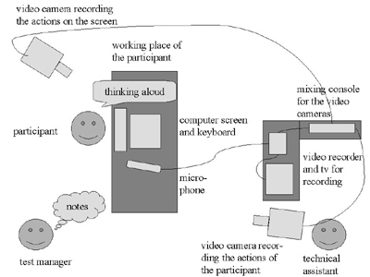
Usability Laboratories

Slide 17
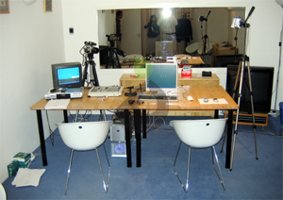
Usability Laboratories

Slide 18
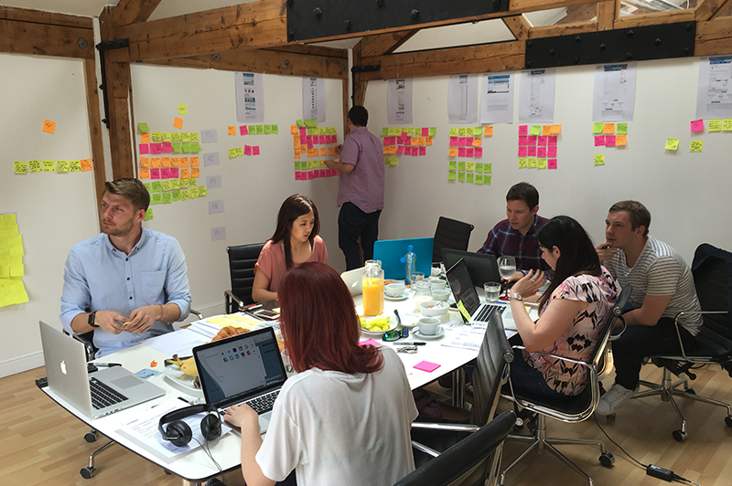
Usability Laboratories

Slide 19
Model of Usability Measurement
Goal:
usability
Component:
Learnability : Guessability
Quantification:
Ease of use of the system
Without training
Measurement Method:
Time to create first entry/time to perform first task
Data Collection technique:
Stopwatch (with rules for when to start and stop the watch) worst case, planned level and best case.

Slide 20
Model of Usability Measurement
Goal:
usability
Component:
Efficiency of use
Measurement Method:
User brought to lab, given list of the tasks and performs them without help
Quantification:
Average time needed to
perform five specified tasks
Data Collection technique:
Stopwatch (with rules for when to start and stop the watch)

Slide 21
Model of Usability Measurement
An electronic diary or calendar vs paper based system to keep track of the weekly scheduled meetings
Attribute : Task Migratability
Measuring concept : scheduling a weekly meeting
Measuring method : time to create first entry in diary (enter appointment time and date in diary)
Now level : Time to schedule one appointment * no. of weeks
Worst case : Time to schedule two appointment
Planned level : 1.5 * Time to schedule one appointment
Best case : Time to schedule one appointment

Slide 22
Model of Usability Measurement
An electronic diary or calendar vs paper based system to keep track of the weekly scheduled meetings
Attribute : familiarity/ Guessability
Measuring concept : Ease of using the system (that feature) without training
Measuring method : time to create first entry in diary
Now level : 90 seconds on paper based system (30 seconds to locate/ 60 seconds to make an entry)
Worst case : 90 seconds
Planned level : 45 seconds
Best case : 30 seconds or less

Slide 23
Performance Measurement Techniques… for Usability
Typical quantifiable usability measurements include :
The time users take to complete a specific task.
The number of tasks (or the proportion of a larger task) of various kinds that can be completed within a given time limit.
The ratio between successful interactions and errors.
The time spent recovering from errors.
The number of user errors.
The number of immediately subsequent erroneous actions.
The number of commands or other features that were utilized by the user (either the absolute number of commands issued or the number of different commands and features used).
The number of commands or other features that were never used by the user.

Slide 24
Performance Measurement Techniques… for Usability
The number of system features the user can remember during a debriefing after the test. (Guessability)
The frequency of use of the manuals and/ or the help system, and the time spent using these system elements.
How frequently the manual and/or help system solved the user's problem.
The proportion of user statements during the test that were positive versus critical toward the system.
The number of times the user expresses clear frustration (or clear joy).
The proportion of users who say that they would prefer using
the system over some specified competitor.

Slide 25
Performance Measurement Techniques… for Usability
The number of times the user had to work around an unsolvable
problem.
The proportion of users using efficient working strategies compared to the users who use inefficient strategies (in case there are multiple ways of performing the tasks).
The amount of "dead" time when the user is not interacting with
the system.
The system can be instrumented to distinguish between two kinds of dead time:
response-time delays where the user is waiting for the system, and
thinking-time delays where the system is waiting for the user.
These two kinds of dead time should obviously be approached in different ways.

Slide 26
Test Budget
The usability laboratory or other room used for the test
Administrative assistants to schedule test users, enter data, etc.
Software developers to modify the code to include data collection or other desired test customization
The test users' time: out-of-pocket expense if outside people are hired for the test
Computers used during testing and during analysis
Videotapes and other consumables: out-of-pocket expense

Slide 27
Between-Subjects versus Within-Subjects Testing
Often, usability testing is conducted in order to compare the usability of two or more systems/sub-systems.
If so, there are two basic ways of employing the test users: between-subject testing and within-subject testing.
Between –subject testing :: two user groups

Slide 28
Issues related to Usability… Reliability and Validity
Reliability
Is related to getting the same result if tests are repeated again and again
Reliability of usability tests is a major problem because of the huge individual differences between test users.
Best users Average Users Naïve Users [Egan 1988]
Apprx. 10 times faster :: User A,B and User C,D

Slide 29
Issues related to Usability
Validity
is related to the actual (usability) issue which should get reflected when one wants to test.
Are we targeting the right group??
is there Methodological understanding of the test which has to be performed ?
Is this methodology existing or not ?

Slide 30
Ethical Aspects of Tests with Human Subjects
Users feel a tremendous pressure to perform, even when they are told that the purpose of the study is to test the system and not the user.
Also, They inevitably make errors and are slow at learning the system and as a result they easily get to feel inadequate or stupid as they experience these difficulties.
Knowing the fact that they are being observed, and possibly recorded, makes the feeling of performing inadequately even more
unpleasant to the users.
In some cases test users have been known to break down and cry during usability testing.
The experimenter should take the responsibility to make the users feel comfortable as much as possible during and after the test.
Should be informed that the purpose is to test the system and not the user

Slide 31
Ethical Aspects of Tests with Human Subjects
The users should be told that no information about the performance of any individual users will be revealed and specifically that their manager will not be informed about their performance.
The test session should be conducted without disruptions: typically, one should place a sign saying, "User test in progress- Do not disturb" outside the (closed) door and no mobile phones should be allowed.
The test results should be kept confidential, and reports from the test should be written in such a way that individual test users are not identified.
During testing, the experimenter should normally not interfere
with the user but should let the user discover the solutions to the
problems on his or her own should not let a user struggle endlessly with a task if the user is clearly bogged down and getting desperate.

Slide 32
Usability Assessment Methods beyond Testing…..
Observation
Focus Groups
Logging actual use
User Feedback
Questionnaire
Interviews
Heuristic Feedback
Action Analysis (Performance Measures)
Cognitive Walkthrough

